Slide 1
SNF RRAM Standard Process Flow and Characterization of Lesker-2 TiN
ENGR241 Winter Project Proposal
Project Members: Akash Levy, Jung-Soo Ko
Staff Mentors: Michelle Rincon, Vijay Narasimhan, J Provine

Slide 2
Q2 Motivation
RRAM is used in lots of research groups at Stanford:
Simon Wong, Philip Wong, Subhasish Mitra, Jonathan Fan, Yoshio Nishi, etc.
Difficulties in RRAM processes were shown in a 2015 SNF community service proposal
Many potential issues there:
Used very large device sizes in proposal (100um x 100um)
Patterning devices may cause large sidewall leakage if done naively
Good quality TiN is required for RRAM
Required for low resistivity
Very difficult to do in SNF without oxygen contamination
ALD tools (Fijis + Savannah) have issues with oxygen leakage
Previous E241 projects quantified the issue but did not solve it
Old Lesker takes a very long time to pump down to required level
Developing a high-quality TiN process on new Lesker would be extremely valuable
Collecting standard data and creating a standard RRAM process flow would also be very useful for SNF
SOPs could be easily extended to other types of 2-terminal NVM

Slide 3
Aim & Goals
Test and characterize ALD RRAM devices with different parameters
Create TiN recipe on new Lesker with low oxygen contamination
Make electrical/imaging data and test structure layouts available to SNF
Try to solve the problems with RRAM through parameter optimization
Make SOPs for different RRAM stacks
Process Flow Development
Parameter Optimization
Comprehensive Documentation
SNF Database

Slide 4
Process Flow Outline
SiO₂
SiO₂
SiO₂
Not drawn to scale
Pt
Pt
Si
Si
Si
Start with Si wafer
Standard RCA Clean
Deposit 30nm Pt with AJA
Deposit 100nm SiO₂ with AJA
Etch trench
Clean sidewalls of trench
Active device area
Au
SiO₂
SiO₂
SiO₂
SiO₂
SiO₂
SiO₂
TiN
TiN
HfO₂
HfO₂
HfO₂
Pt
Pt
Pt
Si
Si
Si
Deposit Au with AJA
Pattern top electrodes
Sputter 30nm
TiN with new Lesker
Deposit 5nm HfO₂ with Fiji

Slide 5
Possible Parameters to Optimize
Resistive switching material (metal oxide): alumina, hafnia, zirconia, tantala, titania
Alumina seed layer: none, 1nm, 2nm
Can see if this is necessary early on, ignore if not
Dimensions:
TiN thickness: 5nm, 10nm, 20nm, 30nm
Resistive switching layer thickness: 2nm, 5nm, 8nm, 10nm
Radius of contact: 50um, 20um, 10um, 5um, 2um, 1um (defined by mask so test all)
RS oxide growth temperature: 200C, 250C, 300C
Anneal temperature: none, 300C, 400C
Plasma vs. thermal
Theory: thermal ALD will work better since plasma is known to cause interface traps and can also sputter BE metal
ALD vs. PVD sputtered TiN
Theory: ALD TiN will not work because of oxygen contamination; new Lesker is better option
Sputtered TiN
Optimize: substrate bias, temperature, sputtering gases, etc.
Top contact: Au, Ag

Slide 6
Characterization
All the typical RRAM parameters
I-V curves for FORM/SET/RESET voltages
Pulsed-mode tuning
Endurance, retention
LRS, HRS, ON/OFF window
Imaging of TiN on new Lesker
AFM images for surface roughness
SEM images
XPS/Auger composition
Italicized equipment requires
training
Will use micromanipulator for characterization
Will use fiji1/2 for ALD resistive-switching (RS) oxide
Will use AJA for trench SiO₂ and all metal deposition
Will use new Lesker for TiN and Allen 111X AJA for reference in meantime
How to clean sidewalls? Where to insert cleaning processes?
Will use 3612 resist and standard photolithography workflow
yes/svgcoat/Heidelberg/svgdev/PT-Ox|MTL/gasonics

Slide 7
Tentative Timeline
Week | Description of Activities
1 | Develop process flow, shadow on equipment, do preliminary processing steps (wafer clean, Pt deposition)
2 | Develop layouts, litho training (svgcoat, svgdev, Heidelberg), deposit AJA TiN for comparison Start characterizing AJA TiN (resistivity, composition using XPS/Auger, AFM for surface roughness)
3 | New Lesker training and TiN deposition/characterization (resistivity, compositional analysis, AFM) Finish training and begin processing first sample
4 | Finish processing first sample with AJA TiN, do preliminary electrical characterization Optimize TiN deposition on new Lesker
5 | Process another sample with new Lesker TiN; buffer week
6 | Buffer week to get everything working
7 | Optimize RRAM properties with JUMP and/or test with different materials/layouts
8 | Optimize RRAM properties with JUMP and/or test with different materials/layouts
9 | Optimize RRAM properties with JUMP and/or test with different materials/layouts
10 | Summarize findings, write up SOP, compile data, conclude

Slide 8
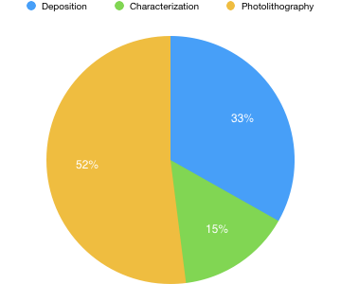
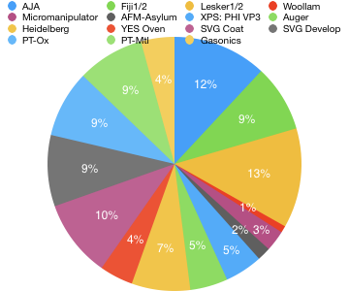
Equipment Usage Budget

Slide 9
Recap of Deliverables
SOP on RRAM process flow with optimized layer thicknesses
Layouts for RRAM test structures
Optimized TiN recipe on new Lesker sputtering system
Optimized electrical characterization testbenches
Electrical characterization data (raw and summarized)
I-V curves, pulsed mode curves
Summary of switching characteristics for different device parameters
All imaging/compositional data (raw and summarized)
AFM
SEM
Auger/XPS

Slide 10
Updates
Past week:
Shadowed on Heidelberg (getting trained on Friday)
Bought 4-in. Si wafers and RCA cleaned
Pt bottom contact deposition with AJA
Finalizing process flow
Developing layout generator in OpenSCAD
Upcoming:
Shadowing/training on SVG tools
Finishing layouts, finalizing process flow

Slide 11
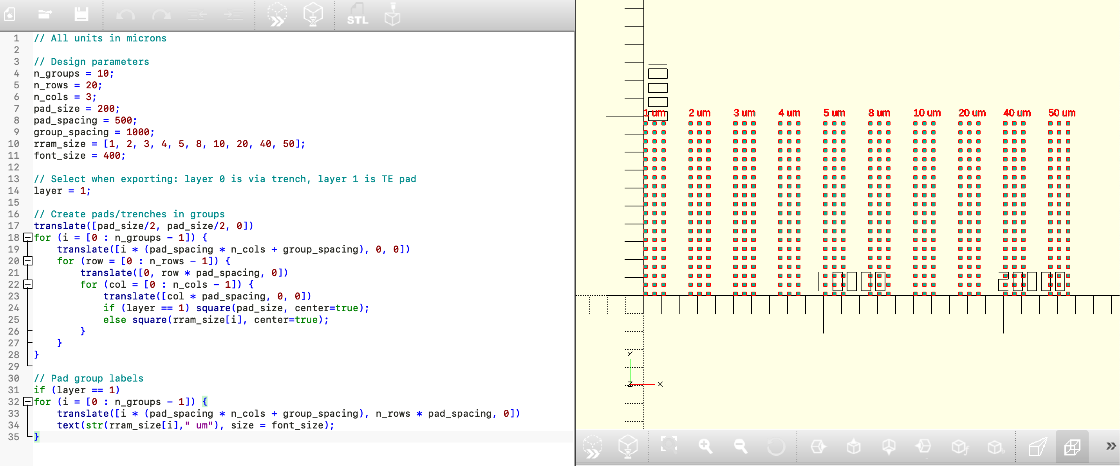
Layout Generator

Slide 12
Thank you!
Questions?

